Slide 1

SE401 - Software Quality Assurance and Testing
Black Box Testing

Slide 2
Outline
Case Study – Knight Capital
Test Driven Development (TDD)
Testing techniques
Black Box Testing
Black Box Testing Techniques
General Testing
Experience based testing

Slide 3
Case Study – Knight Capital High Frequency Trading (HFT)
Notes:
Click to add notes

Slide 4
Case Study – Knight Capital: High Frequency Trading (HFT)
The Knight Capital Group is an American global financial services firm.
Its high-frequency trading algorithms Knight was the largest trader in U.S. equities
with a market share of 17.3% on NYSE and 16.9% on NASDAQ.

Slide 5

Case Study – Knight Capital
Aug 1, 2012.
In the first 45 minutes, Knight Capital's computers executed a series of unusually large automatic orders.
“… spit out duplicate buy and sell orders, jamming the market with high volumes of trades that caused the wild swings in stock prices.”
By the end of day: $460 million loss
“Trading Program Ran Amok, With No ‘Off’ Switch”
In two days, the company's market value plunged by 75%

Slide 6
Case Study – Knight Capital: What Happened?
"Zombie Software" Blamed for Knight Capital Trading Snafu
A new algorithmic trading program had just been installed, and began operation on Aug 1.
A dormant legacy program was somehow "inadvertently reactivated"
Once activated, the dormant system started multiplying stock trades by one thousand
Sent 4 million orders when attempting to fill just 212 customer orders
“Knight’s staff looked through eight sets of software before determining what happened.”

Slide 7
Case Study – Knight Capital: The Investigation and Findings
SEC launched an investigation in Nov 2012. Findings:
Code changes in 2005 introduced defects. Although the defective function was not meant to be used, it was kept in.
New code deployed in late July 2012. The defective function was triggered under new rules. Unable to recognize when orders have been filled.
Ignored system generated warning emails.
Inadequate controls and procedures for code deployment and testing.
Charges filed in Oct 2013
Knights Capital settled charges for $12 million
Notes:
Securities and Exchange Commission (SEC)

Slide 8
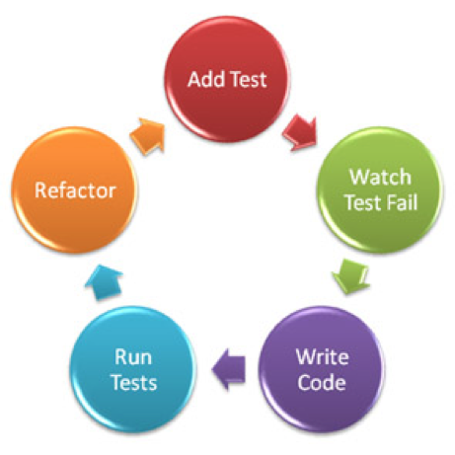
Test Driven Development (TDD)

Slide 9
Test Early
Testing should start as early as possible
design test cases
Test early has several advantages
independence from design & code
discover inconsistencies and incompleteness of the specifications
serve as a compendium of the specifications

Slide 10
Test Driven Development
Test driven development (TDD) is one of the corner stones of agile software development
Agile, iterative, incremental development
Small iterations, a few units
Verification and validation carried out for each iteration.
Design & implement test cases before implementing the functionality
Run automated regression test of whole system continuously

Slide 11
Process of Test Driven Development
Tests should be written first (before any code)
Execute all test cases => all fail
Implement some functions
Execute all test cases => some pass
Repeat implement and re-execute all test cases
Until all test cases => pass
Refactoring, to improve design & implementation
re-execute all test cases => all pass
Every time changes are made
re-execute all test cases => all pass

Slide 12
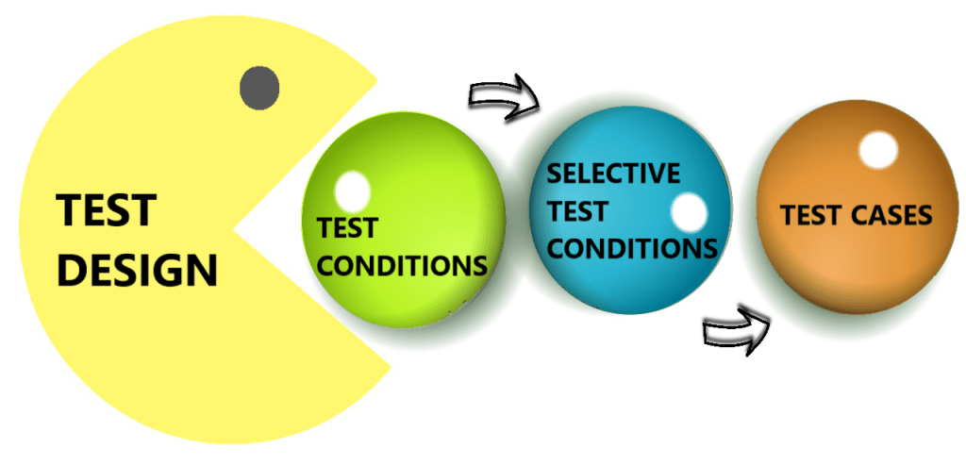
Testing Techniques

Slide 13

Testing techniques
Recall the difference between static and dynamic test techniques:
Static testing
Dynamic testing
Manual examination and automated analysis of code without executing it
code to be executed

Slide 14
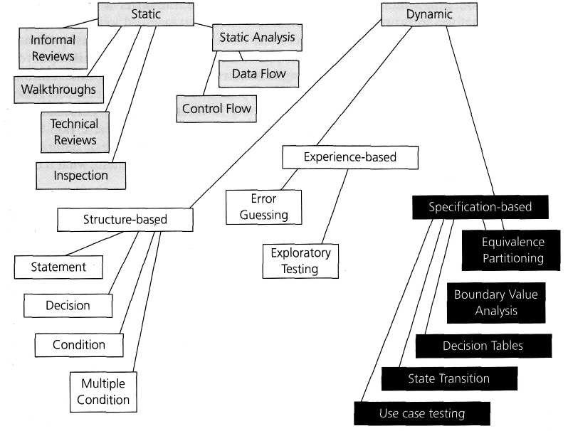
Categories of test design techniques

Slide 15
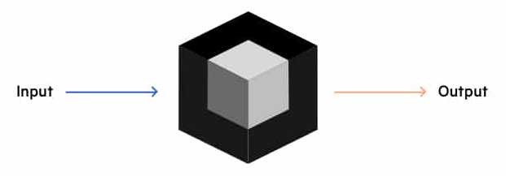
Specification-Based Testing Black Box Testing

Slide 16
Functional Testing: A.k.a.: Black Box Testing
Derive test cases from the functional specifications
functional refers to the source of information
not to what is tested
Also known as:
specification-based testing (from specifications)
black-box testing (no view of the code)
Functional specification = description of intended program behavior
either formal or informal
Notes:
There is a potential confusion of terminology here. Some writers use the term “functional” to distinguish tests of functionality from tests of non-functional program qualities, such as usability. (Often these writers also treat performance and robustness as “non-functional” attributes, although this is questionable.) We use the term “functional” as it has long been used in the testing research community.

Slide 17
Systematic vs. Random Testing
Random (uniform) testing
Pick possible inputs randomly and uniformly
Avoids designer bias
But treats all inputs as equally valuable
Systematic (non-uniform) testing
Select inputs that are especially valuable
Choose representatives
Black box testing is systematic testing
Notes:
The test designer can make the same logical mistakes and bad assumptions as the program designer (especially if they are the same person)

Slide 18

Why Not Random Testing?
Non-uniform distribution of defects
Example:
Program: solve a quadratic equation: a x² + b x + c = 0
Defect: incomplete implementation logic
does not properly handle special cases: b² - 4ac = 0 and a = 0
Failing values are sparse in the input space —
needles in a very big haystack.
Random sampling is unlikely to choose a=0.0 and b=0.0
Notes:
Instructor suggestion: Ask students to attempt to calculate how many uniform random test cases it would take, on average, to find this bug. Encourage them to perform a quick, back-of-the-envelope calculation using reasonable assumptions.
If we assume 32-bit floating point numbers, and that all 32-bit patterns represent legal and distinct numbers (which is not true), then there would be 2^32 different floating point numbers, thus a chance of 1 in 2^32 of choosing zero randomly. The chance of choosing the pair (0.0, 0.0) would then be 1 in 2^64, a very large number.
Since not all bit patterns are valid and distinct floating point numbers, and since very small values of a may cause a detectable failure, in practice random testing will do a little better than this calculation indicates ... but not enough better to make it at all effective. It will take millions of random test cases, on average, to find this bug, while picking a few special values based on the specification will find it very quickly.

Slide 19
Why Not Random Testing?
Estimate how many uniform random test cases it would take, on average, to find this bug. Perform a quick calculation using reasonable assumptions.
If we assume 32-bit floating point numbers, and that all 32-bit patterns represent legal and distinct numbers (which is not true), then there would be 2^32 different floating point numbers, thus a chance of 1 in 2^32 of choosing zero randomly. The chance of choosing the pair (0.0, 0.0) would then be 1 in 2^64, a very large number.
Since not all bit patterns are valid and distinct floating point numbers, and since very small values of a and b may cause a detectable failure, in practice random testing will do a little better than this calculation indicates ... but not enough better to make it at all effective. It will take millions of random test cases, on average, to find this bug, while picking a few special values based on the specification will find it very quickly.

Slide 20
Black Box Testing
Testing software against a specification of its external behavior without knowledge of internal implementation details
Can be applied to software “units” (e.g., classes) or to entire programs
External behavior is defined in API docs, Functional specs, Requirements specs, etc.
Because black box testing purposely disregards the program's control structure, attention is focused primarily on the information domain (i.e., data that goes in, data that comes out)
The Goal: Derive sets of input conditions (test cases) that fully exercise the external functionality

Slide 21
Black-box Testing Errors Categories
Incorrect or missing functions
Interface errors
Usability problems
Concurrency and timing errors
Errors in data structures or external data base access
Behavior or performance errors
Initialization and termination errors
Unlike white box testing, black box testing tends to be applied later in the development process

Slide 22
Questions answered by Black-box Testing
How is functional validity tested?
How are system behavior and performance tested?
What classes of input will make good test cases?
Is the system particularly sensitive to certain input values?
How are the boundary values of a data class isolated?
What data rates and data volume can the system tolerate?
What effect will specific combinations of data have on system operation?

Slide 23
The Information Domain: inputs and outputs
Inputs
Individual input values
Try many different values for each individual input
Combinations of inputs
Individual inputs are not independent from each other
Programs process multiple input values together, not just one at a time
Try many different combinations of inputs in order to achieve good coverage of the input domain
Ordering and Timing of inputs
In addition to the particular combination of input values chosen, the ordering and timing of the inputs can also make a difference

Slide 24
The Information Domain: inputs and outputs
Defining the input domain
Boolean value
T or F
Numeric value in a particular range
-99 <= N <= 99
Integer, Floating point
Non-negative
One of a fixed set of enumerated values
{Jan, Feb, Mar, …}
{Visa, MasterCard, Discover, …}
Formatted strings
Phone numbers
File names
URLs
Credit card numbers
Regular expressions

Slide 25
Black Box Testing
Exploiting the functional specification
Uses the specification to partition the input space
e.g., specification of “roots” program suggests division between cases with zero, one, and two real roots
Test each partition, and boundaries between partitions
No guarantees, but experience suggests failures often lie at the boundaries (as in the “roots” program)
Notes:
This repeats points from an earlier slide, but a quick reminder of what functional testing is may be useful at this point. If you want to push the needle-in-a-haystack analogy, we can think of functional testing as using what we know about haystacks to select the parts where needles are most likely to be found.
With respect to the partition principle: The specification gives us a way to draw pink lines, or to divide the haystack into smaller piles that tend to contain either lots of needles or none.

Slide 26
Why Black Box Testing?
Early.
can start before code is written
Effective.
find some classes of defects, e.g., missing logic
Widely applicable
any description of program behavior as spec
at any level of granularity, from module to system testing.
Economical
less expensive than structural (white box) testing
The base-line technique for designing test cases
Notes:
Of all the kinds of information we could use in partitioning the input space, why is functional (black-box) testing especially important?

Slide 27
Early Black Box Testing
Program code is not necessary
Only a description of intended behavior is needed
Even incomplete and informal specifications can be used
Although precise, complete specifications lead to better test suites
Early test design has side benefits
Often reveals ambiguities and inconsistency in spec
Useful for assessing testability
And improving test schedule and budget by improving spec
Useful explanation of specification
or in the extreme case (as in XP), test cases are the spec

Slide 28
Functional versus Structural: Classes of faults
Different testing strategies (functional, structural, fault-based, model-based) are most effective for different classes of faults
Functional testing is best for missing logic faults
A common problem: Some program logic was simply forgotten
Structural (code-based) testing will never focus on code that isn’t there!

Slide 29
Functional vs. Structural Test
Functional test is applicable in testing at all granularity levels:
Unit test (from module interface spec)
Integration test (from API or subsystem spec)
System test (from system requirements spec)
Regression test (from system requirements + bug history)
Structural test is applicable in testing relatively small parts of a system:
Unit test

Slide 30
Steps: From specification to test cases
Decompose the specification
If the specification is large, break it into independently testable features to be considered in testing
Select representatives
Representative values of each input, or
Representative behaviors of a model
Often simple input/output transformations don’t describe a system. We use models in program specification, in program design, and in test design
Form test specifications
Typically: combinations of input values, or model behaviors
Produce and execute actual tests

Slide 31
From specification to test cases
Notes:
(This is essentially the same information on the previous slide, restated graphically)
A systematic approach to functional testing can be broken down into steps.
First, we break the specification down into independently testable features. This may be trivial if the “specification” is, for example, an interface specification for a single module, but if we are starting from a requirements specification of a whole system then we can expect to break it down into a large number of features for further consideration.
The next step depends on the kind of specification, and might even vary from feature to feature. For some kinds of specifications it is natural to directly identify inputs and choose representative values. For other kinds of specification, especially those that describe some complex behavior that varies over time, we will need to derive some kind of model ... but this is not really extra work, because we will need to derive some kind of model to design the system anyway. (The chapter on model-based testing describes how some important kinds of design model can be used in test design.)
Whether we chose representative values of inputs directly or defined a more suitable model from which to derive representative inputs or behaviors, what we generate next are test specifications rather than fully instantiated test cases. For example, a test case specification might require an input to be “a string of 3 alphabetic characters”, while a corresponding test case would set that value to “xmt”. A test case will also require scaffolding, including some kind of test oracle to distinguish incorrect from correct behavior.
Generating test case specifications often involves combining representative values, as described in the next chapter on combinatorial testing. Scaffolding and run-time support for testing is discussed in chapter 17 on test execution.

Slide 32
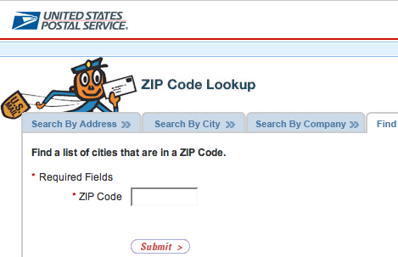
An Example: Postal Code Lookup
Input: ZIP code (5-digit US Postal code)
Output: List of cities
What are some representative values to test?
Notes:
Here is a very simple example taken from the U.S. Postal Service web site. Ask students to suggest a breakdown of values before showing next slide.

Slide 33
Example: Representative Values
Simple example with
one input, one output
Correct zip code
With 0, 1, or many cities
Malformed zip code
Empty; 1-4 characters; 6 characters; very long
Non-digit characters
Non-character data
Note prevalence of boundary values (0 cities, 6 characters) and error cases
Notes:
Here is a possible breakdown of values. Note that while there is only one input, we have considered the output value (a list) as well. Also note that these are mostly classes of values, rather than concrete values --- i.e., we have parts of test case specifications, not concrete test cases.
The prevalence of boundary and error values is typical (and program faults are also disproportionately found in boundary case and error handling).
Did students come up with each of these? If not, do they agree that each of these is a significant case to be tested? Did they come up with any others, and if so, can they explain why the representatives they came up with are also significant cases to be tested?

Slide 34
Summary
Functional testing, i.e., generation of test cases from specifications is a valuable and flexible approach to software testing
Applicable from very early system specs right through module specifications

Slide 35
Black Box Testing Techniques

Slide 36
Single Defect Assumption
Failures are rarely the result of the simultaneous effects of two (or more) defects.

Slide 37
Functional Testing Concepts
The four key concepts in functional testing are:
Precisely identify the domain of each input and each output variable
Select values from the data domain of each variable having important properties
Consider combinations of special values from different input domains to design test cases
Consider input values such that the program under test produces special values from the domains of the output variables

Slide 38
Developing Test Cases
Consider: Test cases for input box accepting numbers between 1 and 1000
If you are testing for an input box accepting numbers from 1 to 1000 then there is no use in writing thousand test cases for all 1000 valid input numbers plus other test cases for invalid data.
Using equivalence partitioning method, above test cases can be divided into three sets of input data called as classes. Each test case is a representative of respective class.
We can divide our test cases into three equivalence classes of some valid and invalid inputs.

Slide 39
Developing Test Cases
One input data class with all valid inputs. Pick a single value from range 1 to 1000 as a valid test case. If you select other values between 1 and 1000 then result is going to be same. So one test case for valid input data should be sufficient.
Input data class with all values below lower limit. I.e. any value below 1, as a invalid input data test case.
Input data with any value greater than 1000 to represent third invalid input class.
So using equivalence partitioning you have categorized all possible test cases into three classes. Test cases with other values from any class should give you the same result.

Slide 40
Equivalence Classes
Equivalence classes are the sets of values in a (quasi-) partition of the input, or output domain
Values in an equivalence class cause the program to behave in a similar way:
failure or success
Motivation:
gain a sense of complete testing and avoid redundancy
First determine the boundaries … then determine the equivalencies

Slide 41
Equivalence Partitioning
A black-box testing method that divides the input domain of a program into classes of data from which test cases are derived
An ideal test case single-handedly uncovers a complete class of errors, thereby reducing the total number of test cases that must be developed
Test case design is based on an evaluation of equivalence classes for an input condition
An equivalence class represents a set of valid or invalid states for input conditions
From each equivalence class, test cases are selected so that the largest number of attributes of an equivalence class are exercised at once

Slide 42
Equivalence Partitioning
Typically the universe of all possible test cases is so large that you cannot try them all
You have to select a relatively small number of test cases to actually run
Which test cases should you choose?
Equivalence partitioning helps answer this question

Slide 43
Equivalence Partitioning
Partition the test cases into "equivalence classes”
Each equivalence class contains a set of "equivalent" test cases
Two test cases are considered to be equivalent if we expect the program to process them both in the same way (i.e., follow the same path through the code)
If you expect the program to process two test cases in the same way, only test one of them, thus reducing the number of test cases you have to run

Slide 44
Equivalence Partitioning
First-level partitioning: Valid vs. Invalid test cases
Valid
Invalid

Slide 45
Equivalence Partitioning
Partition valid and invalid test cases into equivalence classes

Slide 46
Equivalence Partitioning
Create a test case for at least one value from each equivalence class

Slide 47
Equivalence Partitioning
When designing test cases, you may use different definitions of “equivalence”, each of which will partition the test case space differently
Example: int Add(n1, n2, n3, …)
Equivalence Definition 1: partition test cases by the number of inputs (1, 2, 3, etc.)
Equivalence Definition 2: partition test cases by the number signs they contain (positive, negative, both)
Equivalence Definition 3: partition test cases by the magnitude of operands (large numbers, small numbers, both)
Etc.

Slide 48
Equivalence Partitioning
When designing test cases, you may use different definitions of “equivalence”, each of which will partition the test case space differently
Example: string Fetch(URL)
Equivalence Definition 1: partition test cases by URL protocol (“http”, “https”, “ftp”, “file”, etc.)
Equivalence Definition 2: partition test cases by type of file being retrieved (HTML, GIF, JPEG, Plain Text, etc.)
Equivalence Definition 3: partition test cases by length of URL (very short, short, medium, long, very long, etc.)
Same host
Etc.

Slide 49
Equivalence Partitioning
Test multiple values in each equivalence class.
Often you’re not sure if you have defined the equivalence classes correctly or completely, and testing multiple values in each class is more thorough than relying on a single value.

Slide 50
Guidelines for Defining Equivalence Classes
If an input condition specifies a range, one valid and two invalid equivalence classes are defined
Input range: 1 – 10 Eq classes: {1..10}, {x < 1}, {x > 10}
If an input condition requires a specific value, one valid and two invalid equivalence classes are defined
Input value: 250 Eq classes: {250}, {x < 250}, {x > 250}
If an input condition specifies a member of a set, one valid and one invalid equivalence class are defined
Input set: {-2.5, 7.3, 8.4} Eq classes: {-2.5, 7.3, 8.4}, {any other x}
If an input condition is a Boolean value, one valid and one invalid class are define
Input: {true condition} Eq classes: {true condition}, {false condition}

Slide 51
Equivalence Partitioning - examples
Input | Valid Equivalence Classes | Invalid Equivalence Classes
A integer N such that: -99 <= N <= 99 | ? | ?
Phone Number Area code: [200, 999] Prefix: (200, 999] Suffix: Any 4 digits | ? | ?

Slide 52
Equivalence Partitioning - examples
Input | Valid Equivalence Classes | Invalid Equivalence Classes
A integer N such that: -99 <= N <= 99 | [-99, -10] [-9, -1] 0 [1, 9] [10, 99] | ?
Phone Number Area code: [200, 999] Prefix: (200, 999] Suffix: Any 4 digits | ? | ?

Slide 53
Equivalence Partitioning - examples
Input | Valid Equivalence Classes | Invalid Equivalence Classes
A integer N such that: -99 <= N <= 99 | [-99, -10] [-9, -1] 0 [1, 9] [10, 99] | < -99 > 99 Malformed numbers {12-, 1-2-3, …} Non-numeric strings {junk, 1E2, $13} Empty value
Phone Number Area code: [200, 999] Prefix: (200, 999] Suffix: Any 4 digits | ? | ?

Slide 54
Equivalence Partitioning - examples
Input | Valid Equivalence Classes | Invalid Equivalence Classes
A integer N such that: -99 <= N <= 99 | [-99, -10] [-9, -1] 0 [1, 9] [10, 99] | < -99 > 99 Malformed numbers {12-, 1-2-3, …} Non-numeric strings {junk, 1E2, $13} Empty value
Phone Number Area code: [200, 999] Prefix: (200, 999] Suffix: Any 4 digits | 555-5555 (555)555-5555 555-555-5555 200 <= Area code <= 999 200 < Prefix <= 999 | ?

Slide 55
Equivalence Partitioning - examples
Input | Valid Equivalence Classes | Invalid Equivalence Classes
A integer N such that: -99 <= N <= 99 | [-99, -10] [-9, -1] 0 [1, 9] [10, 99] | < -99 > 99 Malformed numbers {12-, 1-2-3, …} Non-numeric strings {junk, 1E2, $13} Empty value
Phone Number Area code: [200, 999] Prefix: (200, 999] Suffix: Any 4 digits | 555-5555 (555)555-5555 555-555-5555 200 <= Area code <= 999 200 < Prefix <= 999 | Invalid format 5555555, (555)(555)5555, etc.. Area code < 200 or > 999 Area code with non-numeric characters Similar for Prefix and Suffix

Slide 56
Determining Equivalence Classes
Look for ranges of numbers or values
Look for memberships in groups
Some may be based on time
Include invalid inputs
Look for internal boundaries
Don’t worry if they overlap with each other —
better to be redundant than to miss something
However, test cases will easily overlap with boundary value test cases

Slide 57
Selecting Data Points
Determining equivalence classes for each input variable or field
Single input variable
Normal test
Select one data point from each valid equivalence class
Robustness test
Include invalid equivalence class

Slide 58
Selecting Data Points
Multiple input variables
Weak normal test:
Select one data point from each valid equivalence class
Strong normal test:
Select one data point from each combination of (the cross product of) the valid equivalence classes
Weak/strong robustness test:
Include invalid equivalence classes
How many test cases do we need?

Slide 59
Example of Selecting Data Points
Suppose a program has 2 input variables, x and y
Suppose x can lie in 3 valid equivalence classes:
a ≤ x < b
b ≤ x < c
c ≤ x ≤ d
Suppose y can lie in 2 valid equivalence classes:
e ≤ y < f
f ≤ y ≤ g

Slide 60
Weak Normal Test
Every normal, i.e., valid, equivalence class of every input variable is tested in at least one test case.
A representative value of each normal equivalence class of each input variable appears in at least one test case.
Economical, requires few test cases if the values are selected prudently.
Complete.

Slide 61
Weak Normal Test
y
g
f
e
a
b
c
d
x

Slide 62
Strong Normal Test
Every combination of normal equivalence classes of every input variable is tested in at least one test case.
More comprehensive.
Requires more test cases.
May not be practical for programs with large number of input variables.

Slide 63
Strong Normal Test
y
g
f
e
a
b
c
d
x

Slide 64
Weak Robustness Test
Add robustness test cases to weak normal test suite.
Every invalid equivalence class of every input variable is tested in at least one robustness test case.
Each robustness test case include only one invalid input value.
No combination of invalid input values.

Slide 65
Weak Robustness Test
y
g
f
e
a
b
c
d
x

Slide 66
Strong Robustness Test
Add robustness test cases to strong normal test suite.
Every invalid equivalence class of an input variable is tested with all combinations of valid equivalence classes of other input variable.
Each robustness test case include only one invalid input value.
No combination of invalid input values.

Slide 67
Strong Robustness Test Cases
y
g
f
e
a
b
c
d
x

Slide 68
Summary
For Multiple input variables
Weak normal test:
Select one data point from each valid equivalence class
Strong normal test:
Select one data point from each combination of (the cross product of) the valid equivalence classes
Weak/strong robustness test:
Include invalid equivalence classes

Slide 69
Example: nextDate() Function
This program reads a date in the format of
mm/dd/yyyy
and prints out the next date.
For example, an input of
03/31/2014
gives an output of
04/01/2014
A constraint (arbitrary, for illustration purpose only)
The year is between 1800 and 2200 inclusive

Slide 70
Example: nextDate(): Valid Equivalence Classes
The valid equivalence classes for the Day
{ 1 ≤ Day ≤ 28 }
{ Day = 29 }
{ Day = 30 }
{ Day = 31 }
The valid equivalence classes for the Month
{ Month has 30 days }
{ Month has 31 days }
{ Month = February }
The valid equivalence classes for the Year
{ Year is not a leap year }
{ Year is a leap year }

Slide 71
Example: nextDate(): Invalid Equivalence Classes
The invalid equivalence classes for the Day
{ Day < 1 } { Day > 31 }
{ Incorrect format of Day } { Illegal characters of Day }
The invalid equivalence classes for the Month
{ Month < 1 } { Month > 12 }
{ Incorrect format of Month } { Illegal characters of Month }
The invalid equivalence classes for the Year
{ Year < 1800 } { Year > 2200 }
{ Incorrect format of Year } { Illegal characters of Year }
Other invalid equivalence classes
{ Incorrect order of Day, Month, Year }
{ Missing Day, Month, or Year }
{ Extra number or character }

Slide 72
Example: nextDate(): Test Cases: Weak Normal
Valid equivalence classes and data points
Day Data Points
{ 1 ≤ Day ≤ 28 } 10
{ Day = 29 } 29
{ Day = 30 } 30
{ Day = 31 } 31
Month
{ Month has 30 days } 04
{ Month has 31 days } 03
{ Month = February } 02
Year
{ Year is not a leap year } 2019
{ Year is a leap year } 2020
Weak normal test cases (4 cases)
02/10/2019
04/29/2019
03/30/2020
03/31/2020

Slide 73
Example: nextDate(): Test Cases: Strong Normal
Strong normal test cases (17 cases)
02/10/2020 02/29/2020
02/10/2019
03/10/2020 03/29/2020 03/30/2020 03/31/2020
03/10/2019 03/29/2019 03/30/2019 03/31/2019
04/10/2020 04/29/2020 04/30/2020
04/10/2019 04/29/2019 04/30/2019
Note: some combinations are invalid, thus excluded
e.g., 02/30/2020

Slide 74
Example: nextDate(): Test Cases: Weak Robustness
Add a test case for each invalid equivalence class
{ Day < 1 } 02/00/2020
{ Day > 31 } 03/36/2019
{ Incorrect format of Day } 02/7/2020
{ Illegal characters of Day } 02/First/2020
{ Month < 1 } 00/10/2019
{ Month > 12 } 15/10/2020
{ Incorrect format of Month } 3/10/2020
{ Illegal characters of Month } Mar/10/2019
{ Year < 1800 } 02/10/1745
{ Year > 2200 } 02/10/2350
{ Incorrect format of Year } 02/10/10
{ Illegal characters of Year } 02/10/’00
{ Incorrect order of Day, Month, Year } 29/03/2008
{ Missing Day, Month, or Year } 02/10
{ Extra number or character } 02/20/2020/2019

Slide 75
Example: nextDate(): Test Cases: Strong Robustness
Add invalid test cases resulting from combination of valid equivalence classes
04/31/2020
02/29/2019 02/30/2019 02/31/2019
02/30/2020 02/31/2020
Ensure each invalid test case contains only one invalid value.
Single defect assumption

Slide 76
Equivalence partitioning
Technique
Inputs/outputs/internal values of the software are divided into groups that are expected to exhibit similar behavior .
Examples
People (woman / man)
Students (bachelor / master)
Tickets (children / youth / adults /older)
Vehicles (gasoline / diesel / electric)

Slide 77
Equivalence partitioning
Technique
Inputs/outputs/internal values of the software are divided into groups that are expected to exhibit similar behavior .
Equivalence partitions can be found for both valid data and invalid data, i.e. values that should be rejected.
Notes
Tests can be designed to cover more than one partitions
Equivalence partitioning is applicable at all levels of testing.
Equivalence partitioning as a technique can be used to achieve input and output coverage

Slide 78
Boundary Value Testing
Test values, sizes, or quantities near the design limits
value limits, length limits, volume limits
null strings vs. empty strings
Errors tend to occur near the extreme values of inputs (off by one is an example)
Robustness:
How does the software react when boundaries are exceeded?
Use input values
at their minimum, just above the minimum
at a nominal value,
at the maximum, just below the maximum

Slide 79
Boundary Value Analysis
A greater number of errors occur at the boundaries of the input domain rather than in the "center"
Boundary value analysis is a test case design method that complements equivalence partitioning
It selects test cases at the edges of a class
It derives test cases from both the input domain and output domain

Slide 80
Guidelines for Boundary Value Analysis
If an input condition specifies a range bounded by values a and b, test cases should be designed with values a and b as well as values just above and just below a and b
If an input condition specifies a number of values, test case should be developed that exercise the minimum and maximum numbers. Values just above and just below the minimum and maximum are also tested
Apply guidelines 1 and 2 to output conditions; produce output that reflects the minimum and the maximum values expected; also test the values just below and just above
If internal program data structures have prescribed boundaries (e.g., an array), design a test case to exercise the data structure at its minimum and maximum boundaries

Slide 81
Boundary Value Analysis
When choosing values from an equivalence class to test, use the values that are most likely to cause the program to fail
Errors tend to occur at the boundaries of equivalence classes rather than at the "center"
If (200 < areaCode && areaCode < 999) { // valid area code }
Wrong!
If (200 <= areaCode && areaCode <= 999) { // valid area code }
Testing area codes 200 and 999 would catch this error, but a center value like 770 would not
In addition to testing center values, we should also test boundary values
Right on a boundary
Very close to a boundary on either side

Slide 82
Boundary Value Analysis
Create test cases to test boundaries of equivalence classes

Slide 83
Boundary Value Analysis - examples
Input | Boundary Cases
A number N such that: -99 <= N <= 99 | ?
Phone Number Area code: [200 .. 999] Prefix: [200 .. 999] Suffix: Any 4 digits | ?

Slide 84
Boundary Value Analysis - examples
Input | Boundary Cases
A number N such that: -99 <= N <= 99 | -100, -99, -98 -10, -9 -1, 0, 1 9, 10 98, 99, 100
Phone Number Area code: [200 .. 999] Prefix: [200 .. 999] Suffix: Any 4 digits | ?

Slide 85
Boundary Value Analysis - examples
Input | Boundary Cases
A number N such that: -99 <= N <= 99 | -100, -99, -98 -10, -9 -1, 0, 1 9, 10 98, 99, 100
Phone Number Area code: [200 .. 999] Prefix: [200 .. 999] Suffix: Any 4 digits | Area code: 199, 200, 201 Area code: 998, 999, 1000 Prefix: 200, 199, 198 Prefix: 998, 999, 1000 Suffix: 3 digits, 5 digits

Slide 86
Input Boundary Values
Test cases for a variable x, where a ≤ x ≤ b
Experience shows that errors occur more frequently for extreme values of a variable.
a
b
x
x(min)
x(min+)
x(nom)
x(max -)
x(max)

Slide 87
Input Boundary Values – 2 Variables
Test cases for a variables x₁ and x₂, where a ≤ x₁ ≤ b and c ≤ x₂ ≤ d
Single defect assumption
x
2
d
c
x
1
a
b

Slide 88
Example: nextDate() – Test Cases: Boundary Values
Additional test cases, valid input
04/01/2019 04/30/2019
03/01/2019 03/31/2019
02/01/2019 02/28/2019
02/29/2020
01/01/2020 12/31/2020
01/01/1800 12/31/2200

Slide 89
Robustness Testing
Test cases for a variable x, where a ≤ x ≤ b
Stress input boundaries
Acceptable response for invalid inputs?
Leads to exploratory testing
Can discover hidden functionality
a
b
x

Slide 90
Robustness Testing – 2 Variables
x
2
d
c
x
1
a
b

Slide 91
Example: nextDate() – Test Cases: Boundary Values
Additional robustness test cases, invalid input
04/00/2019 04/31/2019
03/00/2019 03/32/2019
02/00/2019 02/29/2019
02/30/2020
01/00/2020 12/32/2020
12/31/1799 01/01/2201
00/01/2019 13/01/2019

Slide 92
Boundary Value Analysis - examples
Numeric values are often entered as strings which are then converted to numbers internally [int x = atoi(str);]
This conversion requires the program to distinguish between digits and non-digits
A boundary case to consider: Will the program accept / and : as digits?
Char
/ | 0 | 1 | 2 | 3 | 4 | 5 | 6 | 7 | 8 | 9 | :
47 | 48 | 49 | 50 | 51 | 52 | 53 | 54 | 55 | 56 | 57 | 58
ASCII

Slide 93
Mainstream usage testing
Don't get so wrapped up in testing boundary cases that you neglect to test "normal" input values
Values that users would typically enter during mainstream usage

Slide 94
Worst-Case Testing
Discard the single-defect assumption
Worst-case boundary testing:
Allow the input values to simultaneously approach their boundaries
Worst-case robustness testing:
Allow the input values to simultaneously approach and exceed their boundaries

Slide 95
Worst Case Boundary Testing – 2 Variables
x
2
d
c
x
1
a
b

Slide 96
Worst Case Robustness Testing – 2 Variables
x
2
d
c
x
1
a
b

Slide 97
Limitations of Boundary Value Testing
Doesn’t require much thought
May miss internal boundaries
Usually assumes the variables are independent
Values at the boundary may not have meaning

Slide 98
Boundary value analysis
Notes
Boundary value analysis can be applied at all test levels .
Its relatively easy to apply and its defect finding capability is high
Detailed specifications are helpful.
This technique is often considered as an extension of equivalence partitioning
Boundary values are used for test data selection

Slide 99
Equivalence partitioning and boundary
Why do both equivalence partitioning and boundary value analysis?
Boundary values are usually extreme values
To gain confidence to the system we also want to test it under normal circumstances
Rule of thumb (Closed, valid partitions)
Pick two boundary values ( min and max ), and one value from the middle of the partition.

Slide 100
Guidelines and observations
Equivalence Class Testing is appropriate when input data is defined in terms of intervals and sets of discrete values.
Equivalence Class Testing is strengthened when combined with Boundary Value Testing
Strong equivalence takes the presumption that variables are independent. If that is not the case, redundant test cases may be generated

Slide 101
Decision table testing
Decision tables are a good way
to capture system requirements that contain logical conditions
to document internal system design
to record complex business rules that a system is to implement

Slide 102
Decision table testing
Recall truth tables in mathematical logic :
 | P | Q | P ᴧ Q
Case 1 | T | T | T
Case 2 | T | F | F
Case 3 | F | T | F
Case | F | F | F

Slide 103
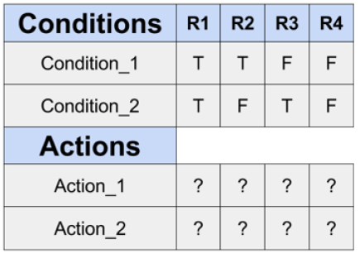
Decision table testing
Decision tables
Cause-effect table
Used when input and actions can be expressed as Boolean
Systematic way of stating complex business rules
Help tester identify effects of combination of different input
Effective approach to reveal faults in the requirements

Slide 104
Decision table testing
When creating decision tables, the specification is analyzed , and actions of the system are identified .
If the input conditions and actions are stated in a way where they are either be true or false (Boolean), decision tables can be
The decision table contains the triggering conditions , i.e. all combinations of true and false for all input conditions, and the resulting actions for each combination of conditions.

Slide 105
Decision table testing
 | Rule 1 | Rule 2 | Rule 3 | Rule 4 | Rule 5 | Rule 6 | Rule 7 | Rule 8
Conditions
Condition 1 | True | True | True | True | False | False | False | False
Condition 2 | True | True | False | False | True | True | False | False
Condition 3 | True | False | True | False | True | False | True | False
Actions
Action 1 | False | False | True | False | False | False | False | False
Action 2 | False | False | False | True | False | False | False | False
Action 3 | True | False | False | False | False | False | False | False
Action 4 | False | False | False | False | True | False | False | False

Slide 106
Decision table testing
The coverage standard commonly used with decision table testing is to have at least one test per column, which typically involves covering all combinations of triggering conditions.
 | Rule 1 | Rule 2 | Rule 3 | Rule 4 | Rule 5 | Rule 6 | Rule 7 | Rule 8
Conditions
Condition 1 | True | True | True | True | False | False | False | False
Condition 2 | True | True | False | False | True | True | False | False
Condition 3 | True | False | True | False | True | False | True | False
Actions | Action 3 | x | Action 1 | Action 2 | Action 4 | x | x | x

Slide 107
Decision table testing
The coverage standard commonly used with decision table testing is to have at least one test per column, which typically involves covering all combinations of triggering conditions.
 | Rule 1 | Rule 2 & 6 | Rule 3 | Rule 4 | Rule 5 | Rule 7 & 8
Conditions
Condition 1 | True | ---- | True | True | False | False
Condition 2 | True | True | False | False | True | False
Condition 3 | True | False | True | False | True | ---
Actions | Action 3 | x | Action 1 | Action 2 | Action 4 | x

Slide 108
Decision table testing
Example-Decision table for credit-card
If you are a new customer opening a credit card account, you will get a 15% discount on all your purchases today.
If are an existing customer and you hold a loyalty card, you get 10% discount.
If you have a coupon, you can get 20% off today (but it can’t be used with a ‘new-customer’ discount)
Discount are added, if applicable.

Slide 109
Decision table testing
 | Rule 1 | Rule 2 | Rule 3 | Rule 4 | Rule 5 | Rule 6 | Rule 7 | Rule 8
Conditions
New customer (15%) | True | True | True | True | False | False | False | False
Loyalty card (10%) | True | True | False | False | True | True | False | False
Coupon (20%) | True | False | True | False | True | False | True | False
Actions
Discount | x | x | 20 % | 15% | 30% | 10% | 20% | 0%

Slide 110
Decision table testing
 | Rule 1 & 2 | Rule 3 & 7 | Rule 4 | Rule 5 | Rule 6 | Rule 8
Conditions
New customer (15%) | True | --- | True | False | False | False
Loyalty card (10%) | True | False | False | True | True | False
Coupon (20%) | --- | True | False | True | False | False
Actions
Discount | x | 20 % | 15% | 30% | 10% | 0%

Slide 111
Decision table testing
Decision tables are a good way to:
capture system requirements that contain logical conditions
to document internal system design.
The input conditions and actions are most often stated in such a way that they can be either true or false (Boolean).
The strength of decision table testing is that it creates combinations of conditions that might not otherwise have been exercised during testing.
It may be applied to all situations when the action of the software depends on several logical decisions.

Slide 112
State transition testing
A system can be in a finite number of different states. This aspects of the system can be described as a ‘finite state machine’ ; a state diagram.
Any system where you get a different output for the same input, depending on what has happened before, is a finite state system.
The transition from one state to another are determined by the rules of the ‘machine’.

Slide 113
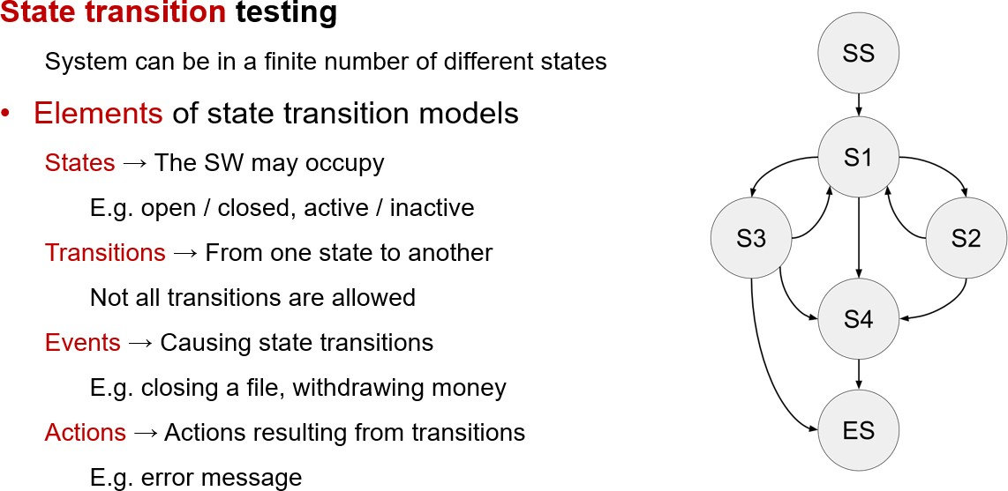
State transition testing
State transition testing
System can be in a finite number of different states
Elements of state transition models
States (The software may occupy)
Open/closed, active/inactive
Transitions (From one state to another)
Not all transitions are allowed
Events (Causing state transition)
Closing a files/withdrawing money
Actions (Action resulting from transitions)
Error message

Slide 114
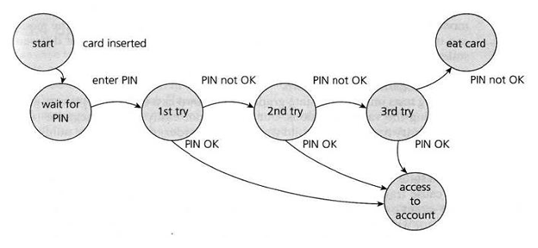
State transition testing
A ‘finite state machine’ is often shown as a state diagram
ATM PIN example.
The states of the system under test are separate, identifiable and finite in number.

Slide 115
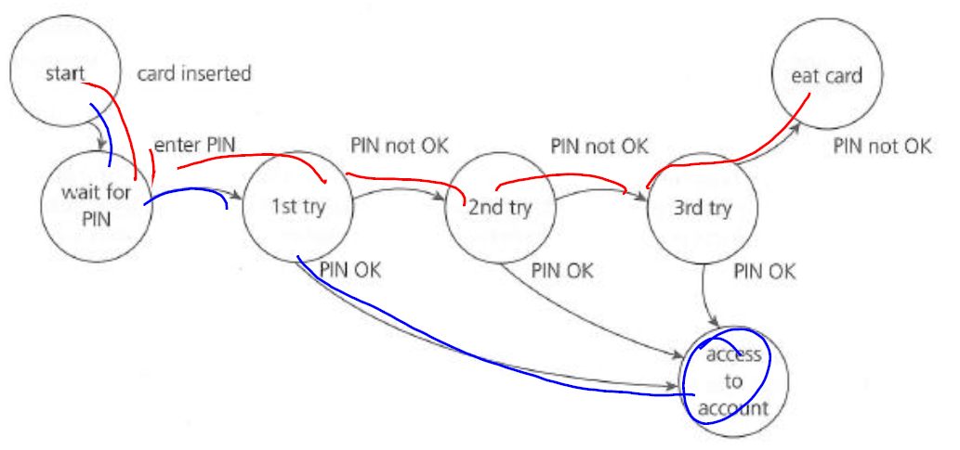
State transition testing
How many tests do we need to exercise every state?
States: States can be numbered as S1, S2 or as alphabets A, B, C etc S1:Start, S2:Wait for Pin, S3: 1st try, S4: 2nd Try, S5: 3rd Try, S6: access to account, S7: eat card Events: Event1:Card inserted, Event 2: enter Pin, Event 3: Pin OK, Event 4: Pin not OK Actions : (not shown in the above example) could be : Messages on the screen – error or otherwise.

Slide 116
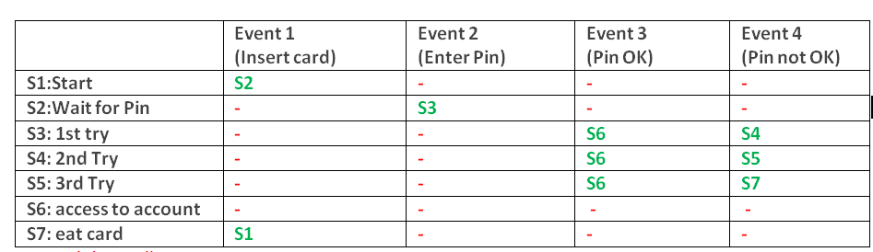
State transition testing
Invalid or Null Transitions are represented as ‘-‘ in red in the table above.

Slide 117
State transition testing
Why state transition testing?
Because a system may exhibit a different response depending on current conditions or previous history.
State transition testing allows the tester to view:
the software in terms of its states
transitions between states
the inputs or events that trigger state changes (transitions)
the actions which may result from those transitions

Slide 118
State transition testing
Tests can be designed
to cover a typical sequence of states
to exercise specific sequences of transitions
to cover every state
to exercise every transition
to test invalid transitions
State transition testing is much used within the software industry and technical automation in general.

Slide 119
Use case testing
Use case describes interactions between actors (users and the system), which produce a result of value to a system user
Example
An on-line training website:
User 1: the learner
User 2: the tutor (instructor)
User 3: the training manager
User 4: the instructional designer

Slide 120
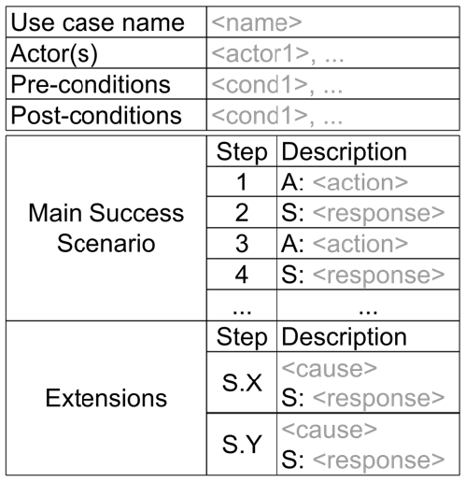
Use case testing
Identify test cases that exercise the whole system on a transaction by transaction basis from start to finish.
Describe interactions between actor and system
Use the language and terms of the business rather than technical terms, especially when the actor is a business user.
Can uncover integration defects, that is, defects caused by the incorrect interaction between different components.

Slide 121
Use case testing
Each use case has pre-conditions, which need to be met for a use case to work successfully.
Each use case terminates with post-conditions, which are the observable resultsand final state of the system afterthe use case has been completed.
A use case usually has a mainstream(i.e. most likely) scenario, and sometimes alternative branches.

Slide 122
Use case testing

Slide 123
Use case testing
Very useful for designing acceptance tests with customer/user participation.
Describe the ‘process flows’ through a system base on its actual likely use.
Derived from use cases are most useful in uncovering defects in the process flows during real-world use of the system.
Help uncover integration defects caused by the integration and interference of different components, which individual testing would not see.
Designing test cases from use cases may be combined with other specification-based test techniques.

Slide 124
Summary: Key Concepts
Black-box testing
vs. random testing, white-box testing
Black box testing techniques
Equivalence class
Boundary value testing
Decision tables
State transition
Use case testing
Single defect assumption
Normal vs. robustness testing
Weak and strong combinations

Slide 125
General Testing

Slide 126
Testing for race conditions and other timing dependencies
Many systems perform multiple concurrent activities
Operating systems manage concurrent programs, interrupts, etc.
Servers service many clients simultaneously
Applications let users perform multiple concurrent actions
Test a variety of different concurrency scenarios, focusing on activities that are likely to share resources (and therefore conflict)
"Race conditions" are bugs that occur only when concurrent activities interleave in particular ways, thus making them difficult to reproduce
Test on hardware of various speeds to ensure that your system works well on both slower and faster machines

Slide 127
Performance Testing
Measure the system's performance
Running times of various tasks
Memory usage, including memory leaks
Network usage (Does it consume too much bandwidth? Does it open too many connections?)
Disk usage (Is the disk footprint reasonable? Does it clean up temporary files properly?)
Process/thread priorities (Does it play well with other applications, or does it hog the whole machine?)

Slide 128
Performance Testing
Tools
IBM Rational Performance Tester
Apache Jmeter
WebLOAD
LoadRunner

Slide 129
Limit Testing
Test the system at the limits of normal use
Test every limit on the program's behavior defined in the requirements
Maximum number of concurrent users or connections
Maximum number of open files
Maximum request size
Maximum file size
Etc.
What happens when you go slightly beyond the specified limits?
Does the system's performance degrade dramatically, or gracefully?

Slide 130
Stress Testing
Test the system under extreme conditions (i.e., beyond the limits of normal use)
Create test cases that demand resources in abnormal quantity, frequency, or volume
Low memory conditions
Disk faults (read/write failures, full disk, file corruption, etc.)
Network faults
Unusually high number of requests
Unusually large requests or files
Unusually high data rates (what happens if the network suddenly becomes ten times faster?)
Even if the system doesn't need to work in such extreme conditions, stress testing is an excellent way to find bugs

Slide 131
Security Testing
Any system that manages sensitive information or performs sensitive functions may become a target for intrusion (i.e., hackers)
How feasible is it to break into the system?
Learn the techniques used by hackers
Try whatever attacks you can think of
Hire a security expert to break into the system
If somebody broke in, what damage could they do?
If an authorized user became disgruntled, what damage could they do?

Slide 132
Security Testing
Tools:
Metasploit
W3af
Zed Attack Proxy (ZAP)
Wapiti

Slide 133
Usability Testing
Is the user interface intuitive, easy to use, organized, logical?
Does it frustrate users?
Are common tasks simple to do?
Does it conform to platform-specific conventions?
Get real users to sit down and use the software to perform some tasks
Watch them performing the tasks, noting things that seem to give them trouble
Get their feedback on the user interface and any suggested improvements
Report bugs for any problems encountered

Slide 134
Usability Testing
Tools:
Crazy Egg
Optimizely
Usabilla

Slide 135
Recovery Testing
Try turning the power off or otherwise crashing the program at arbitrary points during its execution
Does the program come back up correctly when you restart it?
Was the program’s persistent data corrupted (files, databases, etc.)?
Was the extent of user data loss within acceptable limits?
Can the program recover if its configuration files have been corrupted or deleted?
What about hardware failures? Does the system need to keep working when its hardware fails? If so, verify that it does so.

Slide 136
Configuration Testing
Test on all required hardware configurations
CPU, memory, disk, graphics card, network card, etc.
Test on all required operating systems and versions thereof
Virtualization technologies such as VMWare and Virtual PC are very helpful for this
Test as many Hardware/OS combinations as you can
Test installation programs and procedures on all relevant configurations

Slide 137
Compatibility Testing
Test to make sure the program is compatible with other programs it is supposed to work with
Ex: Can Word 12.0 load files created with Word 11.0?
Ex: "Save As… Word, Word Perfect, PDF, HTML, Plain Text"
Ex: "This program is compatible with Internet Explorer and Firefox”
Test all compatibility requirements

Slide 138
Documentation Testing
Test all instructions given in the documentation to ensure their completeness and accuracy
For example, “How To ...” instructions are sometimes not updated to reflect changes in the user interface
Test user documentation on real users to ensure it is clear and complete

Slide 139
Experience-based techniques

Slide 140
Experience-based techniques
Tests are derived from the tester’s skill and intuition and their experience with similar applications and technologies.
When used to augment systematic techniques, experienced based testing can be useful in identifying special tests not easily captured by formal techniques, especially when applied after more formal approaches.
May yield widely varying degrees of effectiveness , depending on the testers experience.

Slide 141
Experience-based techniques
Error guessing = a commonly used experienced-based technique.
Generally testers anticipate defects based on experience.
A structured approach to the error guessing technique is to enumerate a list of possible errors and to design tests that attack these errors.
This systematic approach is called fault attack.

Slide 142
Experience-based techniques
Exploratory testing = concurrent test design, test execution, test logging and learning,
based on a test charter containing test objectives, and carried out within time-boxes.
It is most useful …
where there are few or inadequate specifications
under severe time pressure
to complement other, more formal testing
It can serve to help ensure that the most serious defects are found.

Slide 143
Special Value Testing
The most widely practiced form of functional testing
The tester uses his or her domain knowledge, experience, or intuition to probe areas of probable errors
Other terms: “hacking”, “out-of-box testing”, “ad hoc testing”, “seat of the pants testing”, “guerilla testing”

Slide 144
Uses of Special Value Testing
Complex mathematical (or algorithmic) calculations
Worst case situations (similar to robustness)
Problematic situations from past experience
“Second guess” the likely implementation

Slide 145
Characteristics of Special Value Testing
Experience really helps
Frequently done by the customer or user
Defies measurement
Highly intuitive
Seldom repeatable
Often, very effective

Slide 146
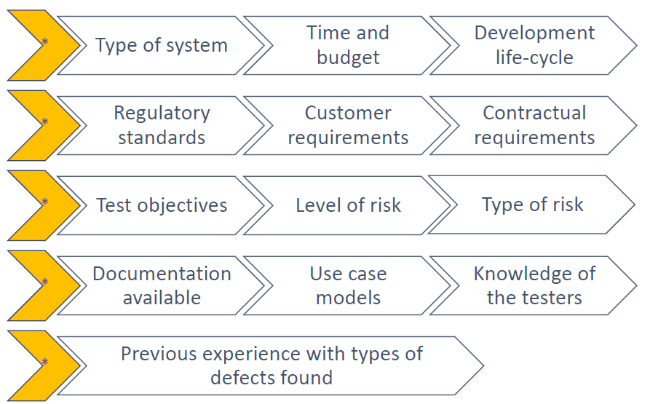
Choosing test techniques
The choice of which test techniques to use depends on a number of factors, including:

Slide 147
Summary
Case Study – Knight Capital
Test Driven Development (TDD)
Testing techniques
Black Box Testing
Black Box Testing Techniques
General Testing
Experience based testing

